Slide 1
git more done
Kwen Peterson
Senior Software Developer @ Raven
kwen.peterson@gmail.com
@kwenarik

Slide 2
"You're already in the top tier of developers just by showing up here tonight. I don't know how talented you are, how much experience you have, but you showed up. You're putting yourself out there because you care to improve. Thanks for caring.“ – Scott Hanselman

Slide 3
Distributed
One of the coolest features of any of the Distributed VCSs, Git included, is that it isn’t centralized.
This means that even if you're using a centralized workflow, every user has what is essentially a full backup of the main server, each of which could be pushed up to replace the main server in the event of a crash or corruption.
There is basically no single point of failure with a distributed VCS.

Slide 4
Git is Fast
Git is extremely fast. Since all operations (except for push and fetch) are local there is no network latency involved to:
Perform a diff.
View file history.
Commit changes.
Merge branches.
Obtain any other revision of a file (not just the prior committed revision).
Switch branches.

Slide 5
Git is orders of magnitude faster than SVN.
Operation | Git | SVN | Speed
Commit Files (A) | 0.64 | 2.60 | 4x
Commit Images (B) | 1.53 | 24.70 | 16x
Diff Current | 0.25 | 1.09 | 4x
Diff Recent | 0.25 | 3.99 | 16x
Diff Tags | 1.17 | 83.57 | 71x
Log (50) | 0.01 | 0.38 | 31x
Log (All) | 0.52 | 169.20 | 325x
Log (File) | 0.60 | 82.84 | 138x
Update | 0.90 | 2.82 | 3x
Blame | 1.91 | 3.04 | 1x

Slide 6
Git is Small
Git's repository and working directory sizes are extremely small when compared to SVN.
The Mozilla repository is reported to be almost 12 Gb stored across 240,000 files in SVN.
The exact same history is stored in Git using two files totaling just over 420 Mb.
This means that SVN requires 30x the disk space to store the same history!
One of the reasons for the smaller repo size is that an SVN working directory always contains two copies of each file: one for the user to actually work with and another hidden in .svn/ to aid operations such as status, diff and commit.
In contrast a Git working directory requires only one small index file that stores about 100 bytes of data per tracked file. On projects with a large number of files this can be a substantial difference in the disk space required per working copy.

Slide 7
Git is *
GitHub
3 million+ users
5 million+ repositories
THE place for open-source projects
Merging & Branching are easy
(unlike in many centralized systems)

Slide 8
The branch Dilemma
I have a 120 hour work package to do!
SVN:
sit on 3 weeks worth of changes unversioned and then finally push 1 massive commit?
push updates to trunk/branch as necessary and possibly break functionality for anyone else working on project (but get to keep commit history, and not have 1 massive commit)
Git:
make daily commits to my local branch (full history, able to rollback to intermediate stages!)
merge in changes that others have pushed to the master branch at my convenience
hold off pushing to master until my code is fully polished and tested out, minimizing impact on other developers

Slide 9
Code Reviews
SVN
Make a patch of uncommitted changes and send it to another developer, and hope that they have an SVN branch at the exact commit as yours to apply it to.
Git
Push a copy of your local branch (and all its commits) out to a remote branch on a repository, where anyone can easily pull down a copy and build your code, no matter where there current branch is.

Slide 10
git-svn
“Git is the best SVN client out there.” – Keith Dahlby
Gives you ALL the local repository benefits of git, while letting you treat your SVN repo as ‘just another remote’

Slide 11
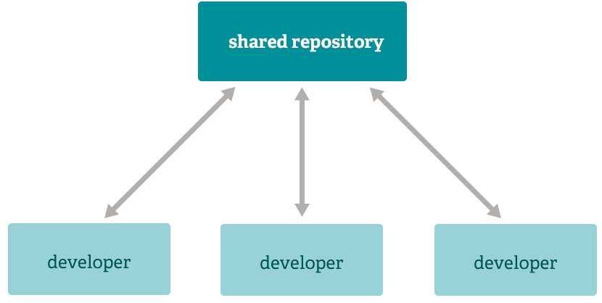
Subversion-Style Workflow

Slide 12
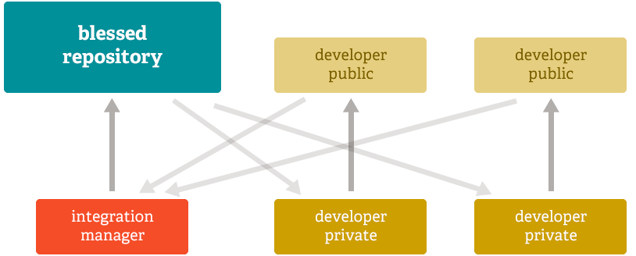
Integration Manager Workflow

Slide 13
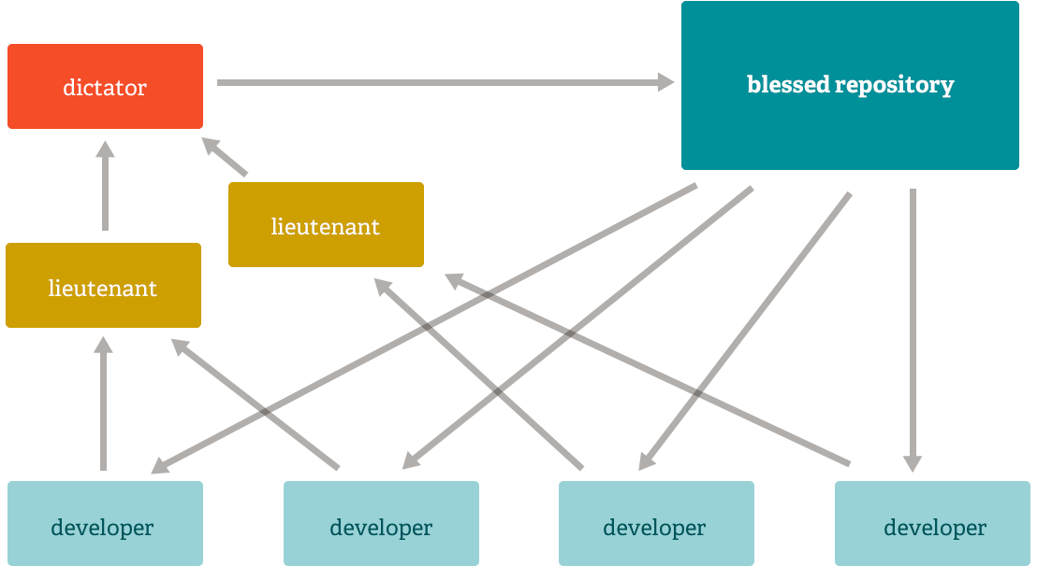
Dictator & Lieutenants Workflow

Slide 14

Felix Baumgartner – Red Bull

Slide 15
Creating a Repository
git init
Creates an empty repository at current location
git clone <url>
Creates a local copy of an existing repository
Examples:
git clone http://github.com/jquery/jquery.git

Slide 16
Working with Remotes
git remote add <name> <url>
Maps a remote
Example: git remote kwen git://source/kwen-test.git
git remote show <name>
Displays a list of branches on the remote, any local branches that track them, fetch URL, etc.
git remote rm <name>
git remote rename <old> <new>

Slide 17
Working with Branches
git checkout <branch>
Change to the specified local branch
git branch <name> <remote>/<branch>
Create a local branch that tracks the remote branch
Example: git branch milestone3 kwen-test/milestone3
git checkout –b <name> <remote>/<branch>
Creates a new local branch and immediately checks it out
Example: git co –b codereview kwen-test/milestone4

Slide 18
Dealing with Changes
git st
Shows you the status of currently modified files (tracked & untracked)
git add <file> (use a gui instead!)
adds the specified file to the list of tracked changes
git commit –m <message> (use a gui instead!)
Commits all tracked changes to the current branch
git reset HEAD –hard
Reset current branch and lose ALL changes
git stash <tag>
Store all current changes away temporarily
The tag is optional, and it will generate one for you if not provided
git stash apply <tag>
Reapply the last set of stashed changes onto the current branch

Slide 19
Pushing and Pulling Changes
git fetch <name>
Gets the latest updates from the remote, but does NOT apply them
Example: git fetch origin
git pull <remote> <branch>
Runs git fetch and then git merge
If you are on a branch that already tracks a remote, you can just use git pull, and it will merge any updates in the tracked remote branch into your local branch.
Can pass a --rebase parameter to rebase instead of merge
git push <remote> <name>:<branch>
Pushes the updates in my current local branch out to a remote branch
Example: git push origin milestone3:milestone3

Slide 20
Git Trivia
Git push origin master:master
Git push origin +master:master
Git push origin –f master:master

Slide 21
Creating & Applying Patches
git format-patch <branch>
Creates patches for the diff between the current branch & <branch>
Example: My local dev branch has updates that have not been committed to origin/dev yet, but that I need to send to Wes. Running git format-patch origin/dev creates patches for each of the commits that are on my local dev branch that are not in origin/dev.
git format-patch -#
Same as above, except this method simply takes the last X commits and creates patches for them.
Example: git format-patch -3 (creates patches for the last 3 commits you made on this branch)
git am -3 –s –i <file or folder>
Apply the specified patches to the current branch
Example: git am -3 –s –i patches/* (applies all the patches located in my \patches folder)

Slide 22
Copy/Paste a commit locally
Git cherry-pick <hash>
Copies the changeset for the given commit onto the current branch
(Great way to apply a hotfix to multiple different branches.)
*

Slide 23

Bug, or…
https://twitter.com/pardel/status/372750244963819522/photo/1

Slide 24

https://twitter.com/GeorgeTakei/status/385913390377750528/photo/1

Slide 25
Common git branching strategy
3 core branches: master, dev, release
Master is “the truth” and should always be in a stable, fully-functional state. This is where new topic/feature branches are cloned from. (nightly builds)
Dev is where integration testing happens. This is where topic branches are pushed and tested PRIOR to being signed off on as stable enough to go to master. (continuous integration, test environment)
Release is where the last live build lives. This exists so that if an absolutely critical issue arises, we can make the fix here and release the build, being confident that the ONLY change going out is the critical bug fix.

Slide 26
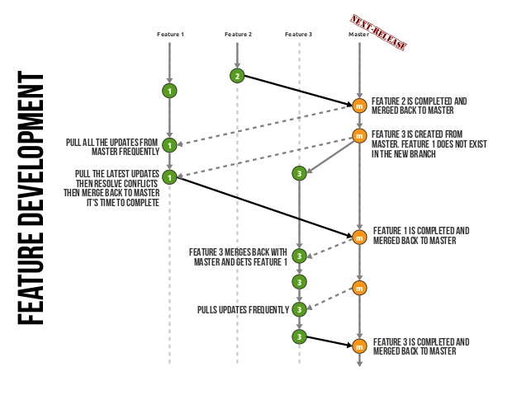

Slide 27
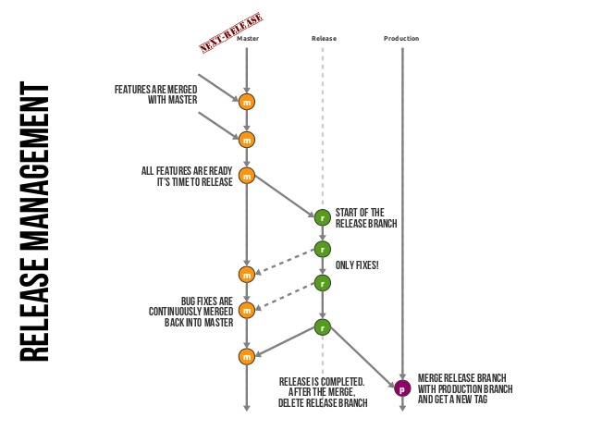

Slide 28

Awesomest. Baby Bib. Ever.

Slide 29
Rebase vs. Merge (1)
Merging brings two lines of development together while preserving the ancestry of each commit history.
In contrast, rebasing unifies the lines of development by re-writing changes from the source branch so that they appear as children of the destination branch – effectively pretending that those commits were written on top of the destination branch all along.

Slide 30


Play Doh

Slide 31
Rebase vs. Merge (2)
Rebase requires the commits on the source branch to be re-written, which changes their content and their SHAS.
Merging is better if you only have one (or few trusted) commiter(s) and you don’t care much about reading your history.
Rebasing makes you sure that your commits go on top of the ‘public’ branch.

Slide 32
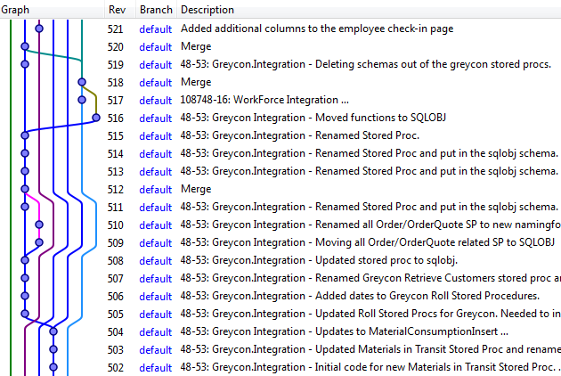
Commit graph (merge)

Slide 33
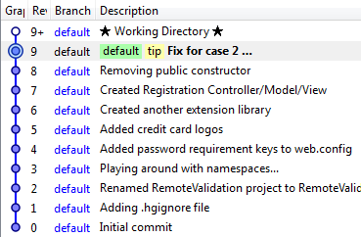
Commit graph (rebase)

Slide 34
Rebase vs. Merge (3)
git merge <branch>
Merge changes in the specified branch onto the current branch
If you run into merge conflicts, the current branch is called local, and the branch you are merging in is referred to as remote.
git rebase <remote>/<branch>
Base the current branch you are on off the specified remote branch
Takes the specified branch as the base, and then applies any changes you have in your local branch on top of that. For conflicts, the current branch is called remote, and the branch you are rebasing off of is treated as local.
Example: git rebase origin/master

Slide 35
Merge
Pros
Simple to use and understand
The commits on the source branch remain separate from other branch commits, provided you don’t perform a fast-forward merge. (This separation can be useful in the case of feature branches, where you might want to take a feature and merge it into another branch later.)
Existing commits on the source branch are unchanged and remain valid; it doesn’t matter if they’ve been shared.
Cons
If the need to merge arises simply because multiple people are working on the same branch in parallel, the merges don’t serve any useful historical purpose & create clutter.

Slide 36
Rebase
Pros
Simplifies your history.
Is the most intuitive and clutter-free way to combine commits from multiple developers in a shared branch.
Cons
Slightly more complex, conflicts require resolution on a per commit basis.
Rewriting of history has ramifications if you’ve previously pushed those commits elsewhere.

Slide 37
Golden Rule of Rebasing
NEVER EVER rebase a branch that you pushed, or that you pulled from another person.

Slide 38


Slide 39
Interactive Rebase (Squash)
git rebase –i HEAD~3
pick f392171 Added new feature X
pick ba9dd9a Added new elements to page design
pick df71a27 Updated CSS for new elements
Change to:
pick f392171 Added new feature X
squash ba9dd9a Added new elements to page design
squash df71a27 Updated CSS for new elements

Slide 40
Reflog, Detached Heads, Submodules
Git reflog – ‘restore points’ for everything you do!
Git reset –hard <hash>
Detached Head – Tracking a specific commit, not a branch!
Submodules – Shared ‘child’ git repository (notorious for detached HEAD issues…)

Slide 41
Resources
Recommended
http://rogerdudler.github.io/git-guide/
http://www.slideshare.net/lemiorhan/git-branching-model?utm_source=slideshow&utm_medium=ssemail&utm_campaign=weekly_digest
Comparison vs. SVN
http://whygitisbetterthanx.com/
http://git-scm.com/course/svn.html
https://git.wiki.kernel.org/index.php/GitSvnComparison
http://zurb.com/article/597/the-one-critical-reason-we-switched-from-
Git Clients
https://code.google.com/p/gitextensions/
http://sourcetreeapp.com/
https://github.com/dahlbyk/posh-git

Slide 42
Kwen Peterson
http://tinyurl.com/rsdcc13
https://github.com/Kwen/sdcc2013
http://speakerrate.com/talks/27811-git-more-done
http://www.slideshare.net/KwenPeterson/git-more-done
@kwenarik #sdcc2013
plus.google.com/+KwenPeterson
kwen.peterson@gmail.com
https://github.com/Kwen

